Slide 1
Information Retrieval
Week 1: Introduction and Foundations of IR - "Why" and the "How" of traditional systems
Saswat Meher

Slide 2
Contents
Introduction to Information Retrieval (IR)
What is IR
Why do we need IR
Where do we need IR
How does IR works
Evolution of IR
Classical systems for IR
Foreshadowing of upcoming contents
Demo for classical IR system
https://nlp.stanford.edu/IR-book/html/htmledition/irbook.html

Slide 3
What is Information retrieval?
Information retrieval (IR) is ‘finding material’ (usually documents) of an unstructured nature (usually text) that satisfies an ‘information need’ from within ‘large collections’ (usually stored on computers).
‘finding material’ - Retrieval
‘information need’ - Query
‘large unstructured collections’ - Corpus

Slide 4
Information Retrieval vs Data Retrieval
Feature | Data Retrieval (DR) | Information Retrieval (IR)
Data Structure | Structured (Database) | Unstructured (Text/Docs)
Query Type | Structured (e.g., SQL) | Keywords/Natural Language
Precision | Exact match needed | Approximate match/Relevance
Result | Precise (Set of records) | Ranked (Relevant items)

Slide 5
Information Retrieval vs Information Extraction (IE)
Information Extraction goes a step further than IR.
Instead of just finding documents, it digs into those documents to extract specific pieces of information.
IR: Search and retrieve. (Searching the web, finding research papers)
IE: Analyze and extract. (Data analysis, extracting facts from reports.)

Slide 6
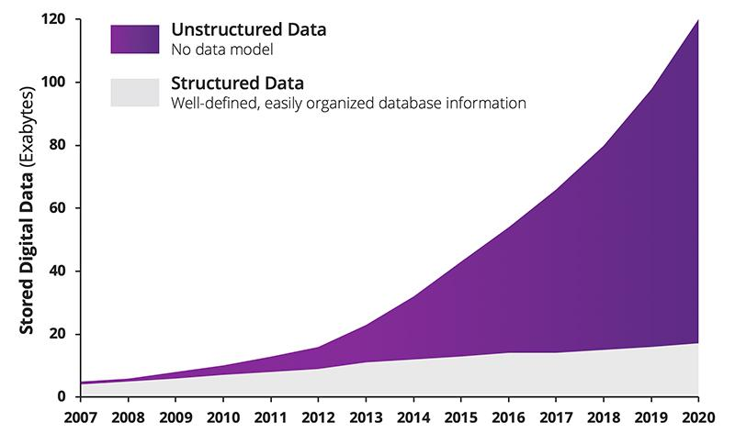
Why do we need Information retrieval?
Unstructured data:
PDF documents, raw text files
Images, Audio, Videos
Semi Structured data:
HTML pages
Social Networks
XML files, JSON objects
CSV, Excel files
Email bodies/headers
Machine generated semi/unstructured data:
IoT Sensor Logs, Network Traffic Dumps
[Link]

Slide 7
Where do we need Information retrieval?
Different Modalities on which IR is applied:
Text: Documents, Social Media posts, Web Content, Chat and Communication
MultiMedia Data: Image, Video, Audio
Graph Structure Data: Social Networks, Web Page hyperlinks, Molecule Structures
MultiModal: WebPages are Multimodal
It contains Texts, Images, Tables, semi structures in the form of HTML, Hyperlinks builds a Graph with each webpage as node

Slide 8

Examples of Information Retrieval
Document Searching
Query: Text
Corpus: Text

Slide 9
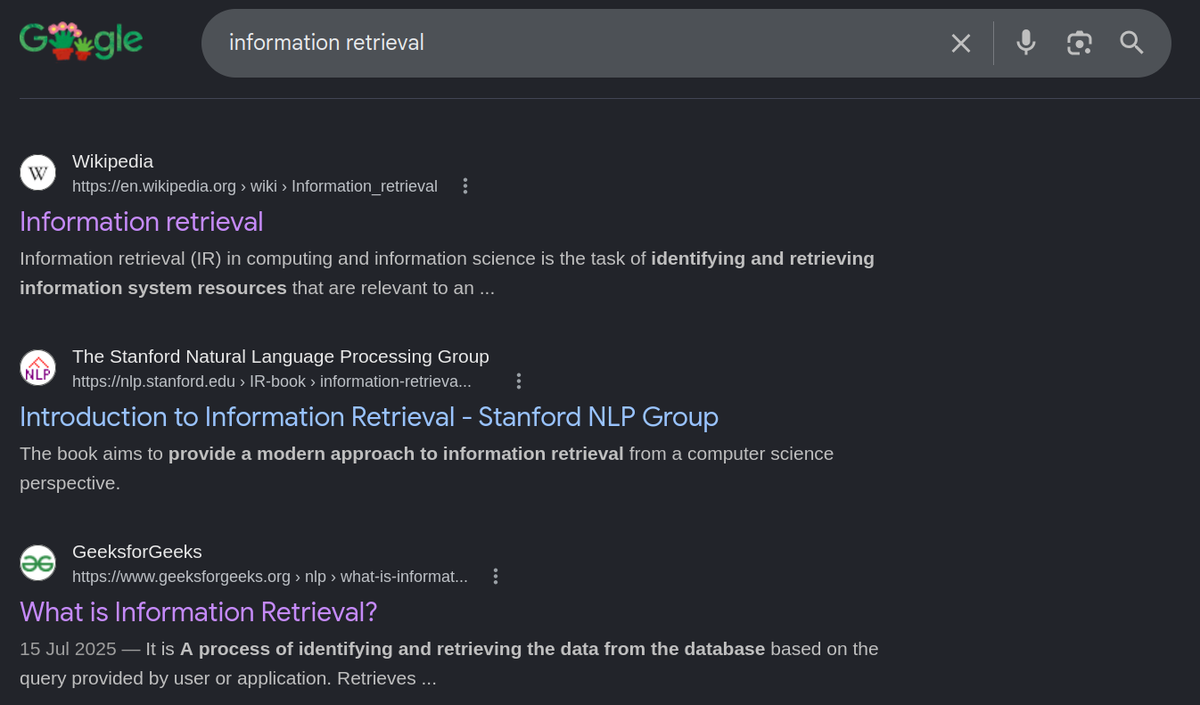
Examples of Information Retrieval
Searching on Web Pages Query: Text Corpus: webpages

Slide 10
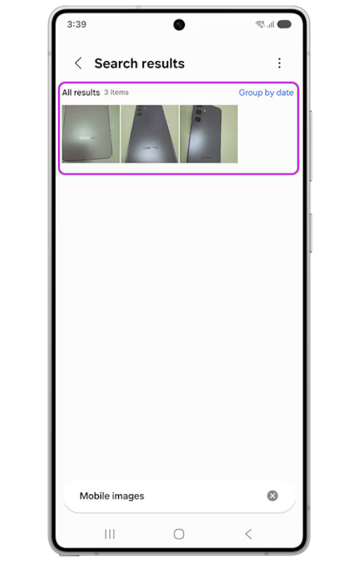
Examples of Information Retrieval
Image Searching
Gallery App - Natural Language Search
Query: Text
Corpus: Image
[Link]

Slide 11
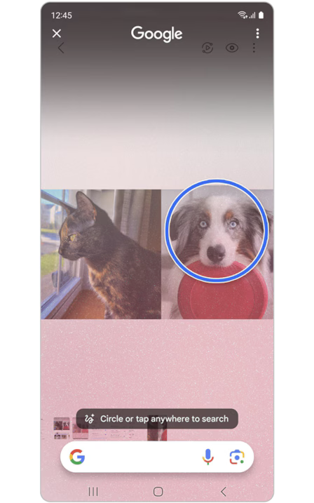
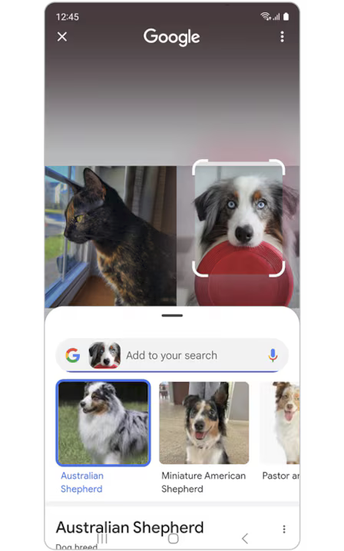
Examples of Information Retrieval
Similar Image Searching
Circle to Search
Query: Image
Corpus: Image
[Link]

Slide 12
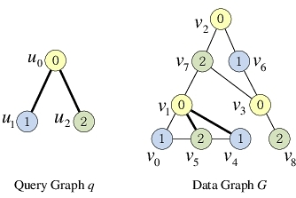
Examples of Information Retrieval
Sub Graph Searching
Query: Graph Corpus: Graph
[Link]

Slide 13
Plan for the sessions
Week 1: Introduction and Foundations of IR - "Why" and the "How" of traditional IR systems
Week 2: Evaluation & Measurement - building a "Golden Set"
Week 3: The Neural Shift – Dense Retrieval - "Bag of words" to "Semantic Search"
Week 4: Reranking & Multi-Stage Pipelines - Building of an end to end retrieval pipeline
Week 5: Graph-Based & Multimodal Retrieval - Expanding search beyond text
Week 6: Vector Databases & Efficient Scaling - The "infrastructure" of AI search
Week 7: Hybrid Search - Vector search is not enough
Week 8: Advanced Retrieval Techniques - Query expansion, Personalized retrieval
Week 9: Retrieval Augmented Generation (RAG) - Connecting search to LLMs
Week 10: Productionizing & Future Trends - Bridging the gap between research and "Day 2" operations

Slide 14
How does Information Retrieval works
How does a IR system works
Copus Collection (Web-crawling)
Indexing
Searching
Goal:
Efficient Indexing
Faster and Better Searching

Slide 15
Classical systems for IR: Indexing
Document processing
Choosing a document unit
Preprocessing
Lowercasing
Lemmatization (uses dictionary lookup to find the meaningful base word. Eg. achieving -> achieve)
Stemming (heuristic process that cuts endings. Eg. achieving -> achiev)
Removing non alphanumeric characters
Tokenization
Query and Document should have same tokenizer

Slide 16
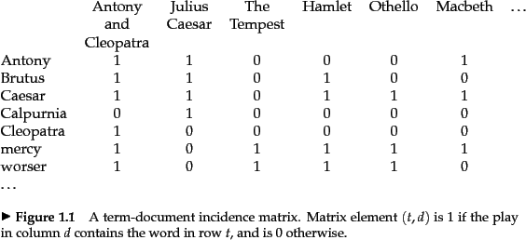
Classical systems for IR: Indexing
Document retrieval task
Query: set of terms
With AND or OR operation
Corpus: Text Documents
Term-Document matrix
Vector Space model
Sparse Retrieval
Lots of 0s and few 1s
Boolean retrieval
AND or OR operation
E.g.
Query: “Caesar AND Cleopatra”
Retrieved Docs: {“Antony and Cleopatra”}
[Link]

Slide 17
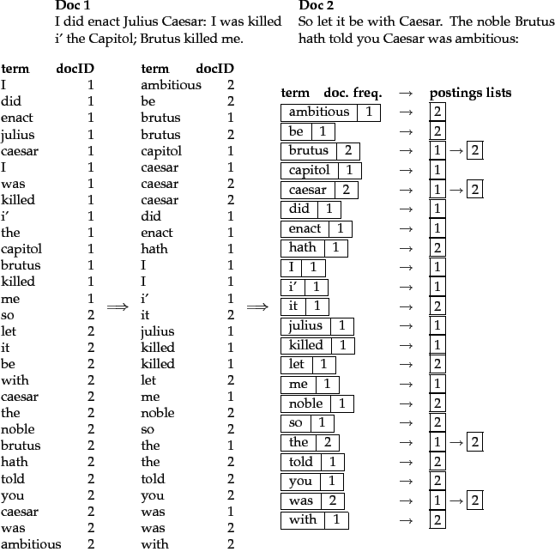
Classical systems for IR: Indexing
99.9% of cells are zero
Why not only store ones
Inverted Index
Document Dictionary
Mapping between doc and docId
Term Dictionary
Mapping between term and termId
Posting list
List of doc for each term
Keep count of doc frequency of term

Slide 18
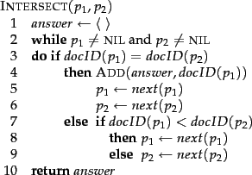
Classical systems for IR: Boolean Retrieval
For a query ``` t1 & t2``` result is intersection of posting list of t1 and t2

Slide 19
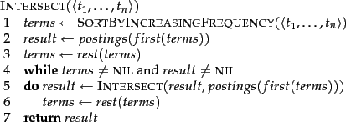
Classical systems for IR: Multiple Term Boolean Retrieval
Iteratively perform intersection
In which order we should choose posting lists?

Slide 20
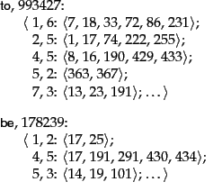
Classical systems for IR: Term Proximity Retrieval
What if you want your query terms to be in close proximity of each other
“Samsung Research”
Both term should be in proximity of each other
Positional indexes
Store position on which it appears in each doc

Slide 21
Classical systems for IR: Ranked Retrieval
Until now it has been Boolean Queries Retrieval
Retrieve a set of document relevant to our query.
It was helpful for professionals who knew what to search and how to search
E.g. Legal documents search
E.g. Software documentation search
Greater control and transparency over what is retrieved
General “text queries”:
Better determine the set of terms in the dictionary
Search for compounds or phrases that denote a concept such as ``operating system''.
Not only whether a term is presence, where it is present, how many times it is present.
Instead of retrieving a set of matching documents, order (or ``rank'') the returned results.
To rank documents we need to score them.
Bag of Words based retrieval

Slide 22
Classical systems for IR: Scoring/Ranking
What if we can score each document in terms of it relevance to a query.
Bag of Words retrieval function
TF-IDF (Term Frequency–Inverse Document Frequency)
TF(t, d) = (number of times term t appears in document d) / (total number of terms in d)
DF(t) = number of documents that contain term t
IDF(t, D) = ln( total number of documents / (1 + DF(t)) ) = ln( |D| / (1 + DF(t)) )
TF-IDF(t, d, D) = TF(t, d) × IDF(t, D)
TF-IDF(q, d) = sum_{ t in q }{ TF-IDF(t, d) }
A term that appears frequently in a particular document but not across the entire collection will receive a high TF-IDF score.

Slide 23
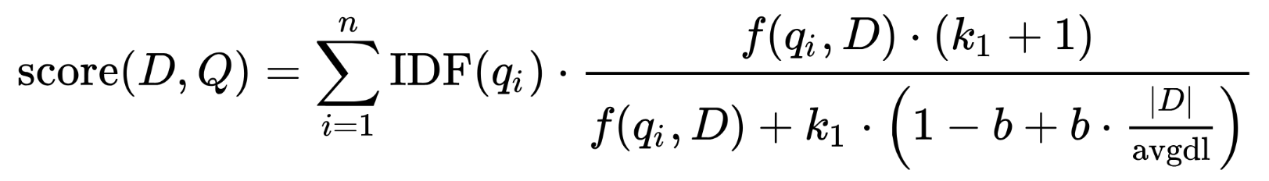
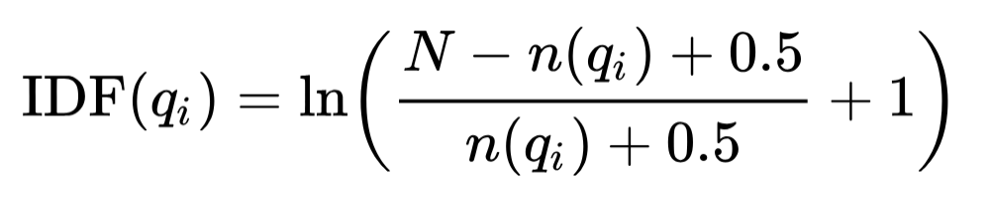
Classical systems for IR: Better Scoring
BM25 is a refinement of TF-IDF
f(q_i, D) is the usual term frequency of q_i in document D.
k1 and b are free parameters to decide to controls how much extra credit a term gets for appearing one more time.
In IDF(qi), n(qi) is the number of document containing qi.
Aggressively downweights frequent terms and upweights rare terms

Slide 24
Classical systems for IR: Better Scanning
Three primary strategies used to process queries and rank documents
Term-at-a-Time (TAAT):
The engine takes the first word of the query, finds every document containing it, and creates (or updates) an "accumulator" for each of those documents. Then it moves to the second word and updates those same accumulators.
Pros: Faster for simple scoring models because it involves linear scans of single lists, which is very cache-friendly for CPUs.
Cons: Requires significant memory. You must maintain an accumulator for every document that contains at least one query term until the very end of the process. If your index has millions of documents, this becomes expensive.
https://web.stanford.edu/class/cs276/handouts/efficient_scoring_cs276_2013_6.pdf

Slide 25
Classical systems for IR: Better Scanning
Document-at-a-Time (DAAT):
The engine looks at the first DocID present in all (or any) of the term lists, calculates the total score for that document, and then moves to the next DocID.
Pros: Very memory efficient because you only need to keep the score of the current document in memory.
We can use Top-K ranking using algorithms like MaxScore or WeakAND.
Cons: Can be slow if the query contains many terms, as it requires "zippering" multiple long lists together.

Slide 26
Classical systems for IR: Better Scanning
Score-at-a-time (newer approaches):
The lists are sorted by the impact (contribution to the score) of the term in that document.
The engine processes the highest-scoring occurrences across all terms first. It moves through the index based on the magnitude of the score contribution rather than the document sequence or the term sequence.
Pros: It allows for extremely aggressive "early termination."
Cons: Building and maintaining an impact-sorted index is more complex than a standard DocID-sorted inverted index.

Slide 27
Safe vs non-safe ranking
The terminology “safe ranking” is used for methods that guarantee that the K docs returned are the K absolute highest scoring documents
Is it ok to be non-safe?
If it is – then how do we ensure we don’t get too far
from the safe solution?
How do we measure if we are far?
https://web.stanford.edu/class/cs276/handouts/efficient_scoring_cs276_2013_6.pdf

Slide 28
Classical systems for IR: Better Indexing
Distributed Indexes [Link]
Index Compression
Dictionary Compression
Posting Lists Compression

Slide 29
Classical systems for IR: Query Processing
Use same Tokenizer
Correct Misspelling
Isolated-term
Context sensitive

Slide 30
Classical systems for IR: Demo

Slide 31
Classical systems for IR: Conclusion

